Slide 1
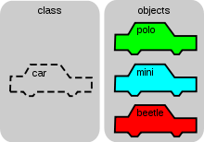
Object Oriented Concepts
Object Basics

Slide 2
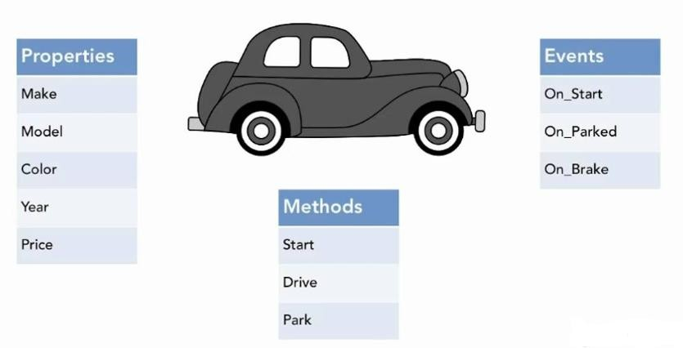

Slide 3
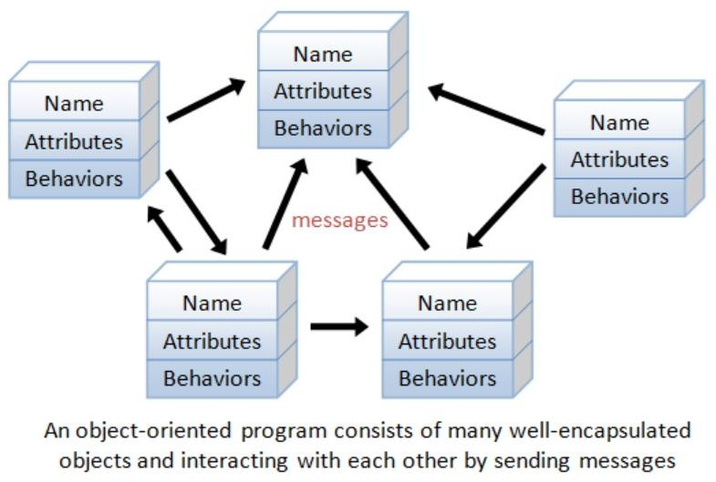

Slide 4
Object
In object-oriented programming (OOP), objects are the units of code that are eventually derived from the process.
Each object is an instance of a particular class.
They have,
Properties or attributes
Describe the state of an object
Methods or procedures
Define its behavior

Slide 5
An Object-Oriented Philosophy
Traditional development methodology
Algorithm-centric methodology
Think algorithm, then build data structures
Data-centric methodology
Think how to structure data, then build algorithm
Object-oriented programming
Allows the basic concepts of the language to be extended to include ideas and terms closer to those of its applications.
The algorithm and data are packaged together as an object, which has a set of attributes or properties.

Slide 6
Objects
The term Object means a combination of data and logic that represents some real world entity.
In an object-oriented system, everything is an object.

Slide 7
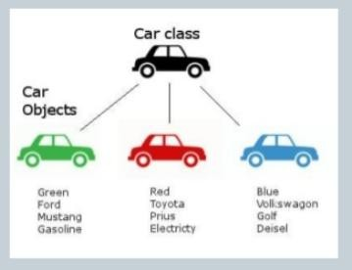
Objects are grouped in Classes

Slide 8
Classes are used to distinguish one type of object from
another.
A class is a set of objects that share a common structure and
behavior.
A single object is simply an instance of a class.
A class is a specification of structure (instance variables),
behavior (methods) and inheritance for objects.
Classes are an important mechanism for classifying objects.
A method or behavior of an object is defined by its class.
Each object is an instance of a class.
Eg) Objects of the class Employee

Slide 9
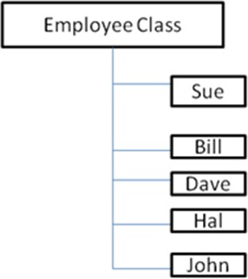

Slide 10
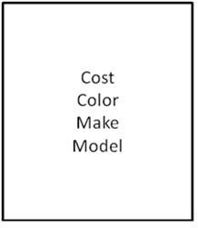
Attributes: Object state and Properties
Properties represent the state of an object. Eg) the attributes of a car object

Slide 11
Object Behavior and Methods
In the object model, object behavior is described in methods or procedures.
A method implements the behavior of an object.
A method is a function or procedure that is defined for a class and typically can access the internal state of an object of that class to perform some operation.
Behavior denotes the collection of methods that abstractly
describes what an object is capable of doing.
The object is that on which the method operates.
Methods encapsulate the behavior of the object, provide interfaces to the object, and hide any of the internal structures and states maintained by the object.

Slide 12
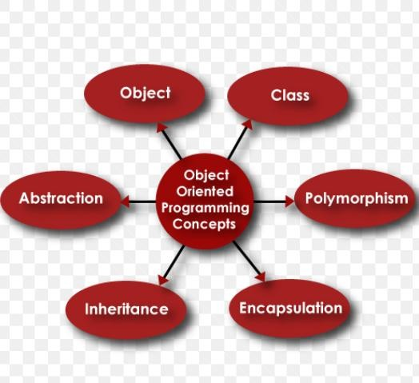

Slide 13
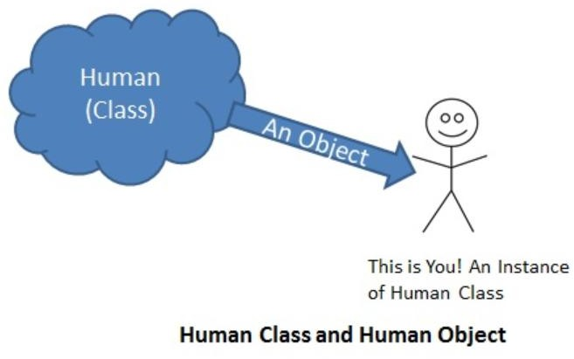
Class and Object

Slide 14
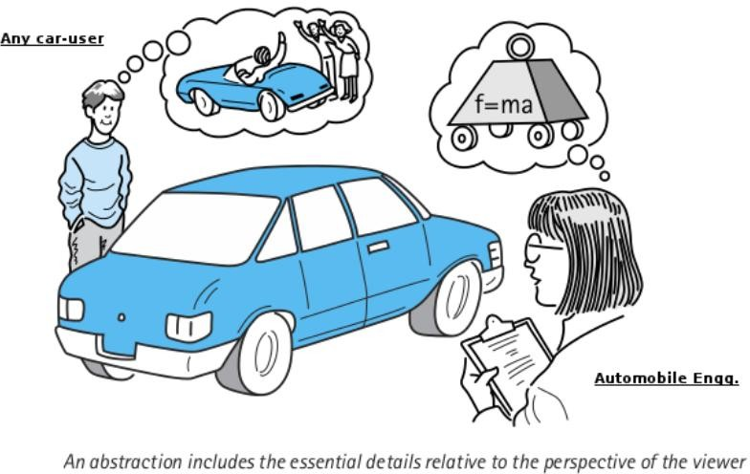
Abstraction

Slide 15
Abstraction means displaying only essential information and hiding the details.
Data abstraction refers to providing only essential information about the data to the outside world, hiding the background details or implementation.
Consider a real life example of a man driving a car.

Slide 16
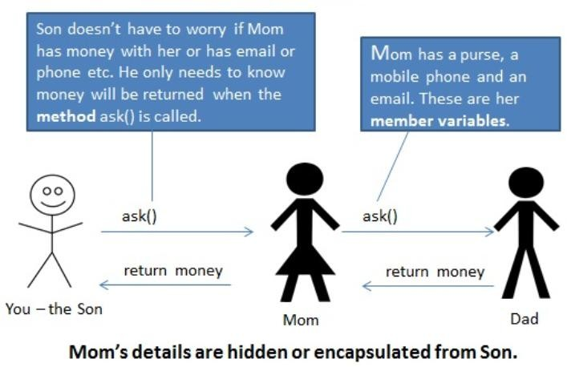
Encapsulation

Slide 17
Encapsulation and Information Hiding
Principle of concealing the internal data and procedures of an object and providing an interface to each object in such a way as to reveal as little as possible about its inner workings.
Eg) C++ has a very general encapsulation protection mechanism with public, private and protected members.
Public members may be accessed from anywhere.
Private members are accessible only from within a class.
Protected members can be accessed only from subclasses.

Slide 18
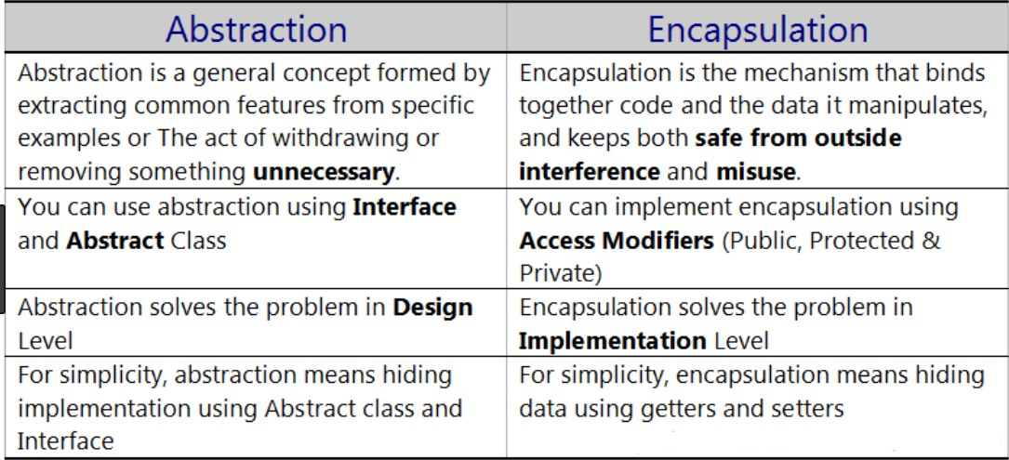

Slide 19
Class Hierarchy
An object-oriented system organizes classes into subclass-superclass hierarchy.
At the top of the class hierarchy are the most general classes and at the bottom are the most specific.
A subclass inherits all of the properties and methods defined in its superclass.
A class may simultaneously be the subclass to some class and a superclass to another class or classes.

Slide 20
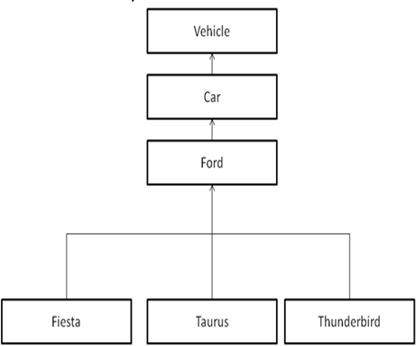

Slide 21
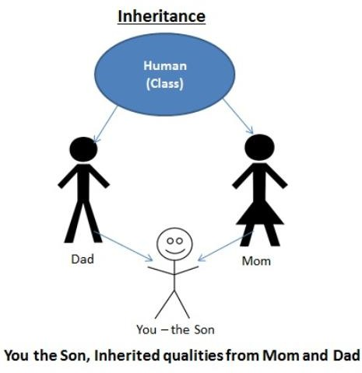
Inheritance

Slide 22
It is the property of object-oriented systems that allows objects to be built from other objects.
Inheritance is a relationship between classes where one class is the parent class of another (derived) class.
The parent class is known as the base class or superclass.
Inheritance allows reusability.
Eg) the stop method may not be defined in Taurus class but it would be defined in Ford class. Then Taurus can reuse that method from Ford.
Dynamic inheritance allows objects to change and evolve over time.
It refers to the ability to add, delete, or change parents from objects or classes at run time.

Slide 23
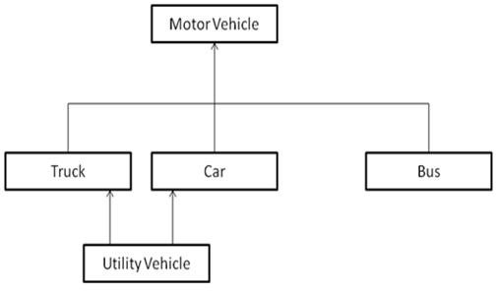
Multiple Inheritance
Some object-oriented systems permit a class to inherit its state and behaviors from more than one superclass.
This kind of inheritance is referred to as multiple inheritance.

Slide 24
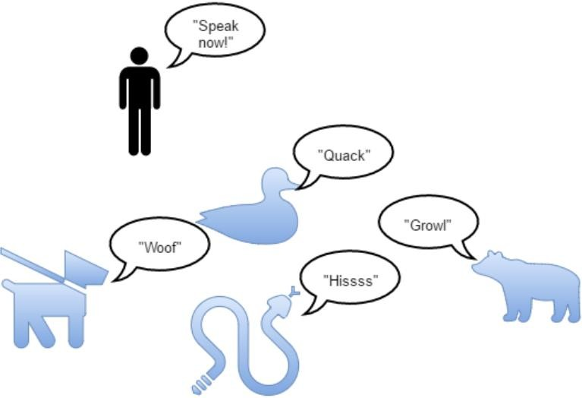
Polymorphism

Slide 25
It means objects that can take on or assume many different forms.
The same operation may behave differently on different classes.
Allows us to write generic, reusable code more easily.

